Slide 1
STATE DESIGN PATTERN
SWE 530 GROUP A

Slide 2
DEFINITION
State is a behavioral design pattern that lets an object alter its behavior when its internal state changes. It appears as if the object changed its class. [1]

Slide 3
PROBLEM
At any given moment, there’s a finite number of states which a program can be in.
Within any unique state, the program behaves differently, and the program can be switched from one state to another instantaneously.
depending on a current state, the program may or may not switch to certain other states.
These switching rules, called transitions, are also finite and predetermined. [1 ]

Slide 4
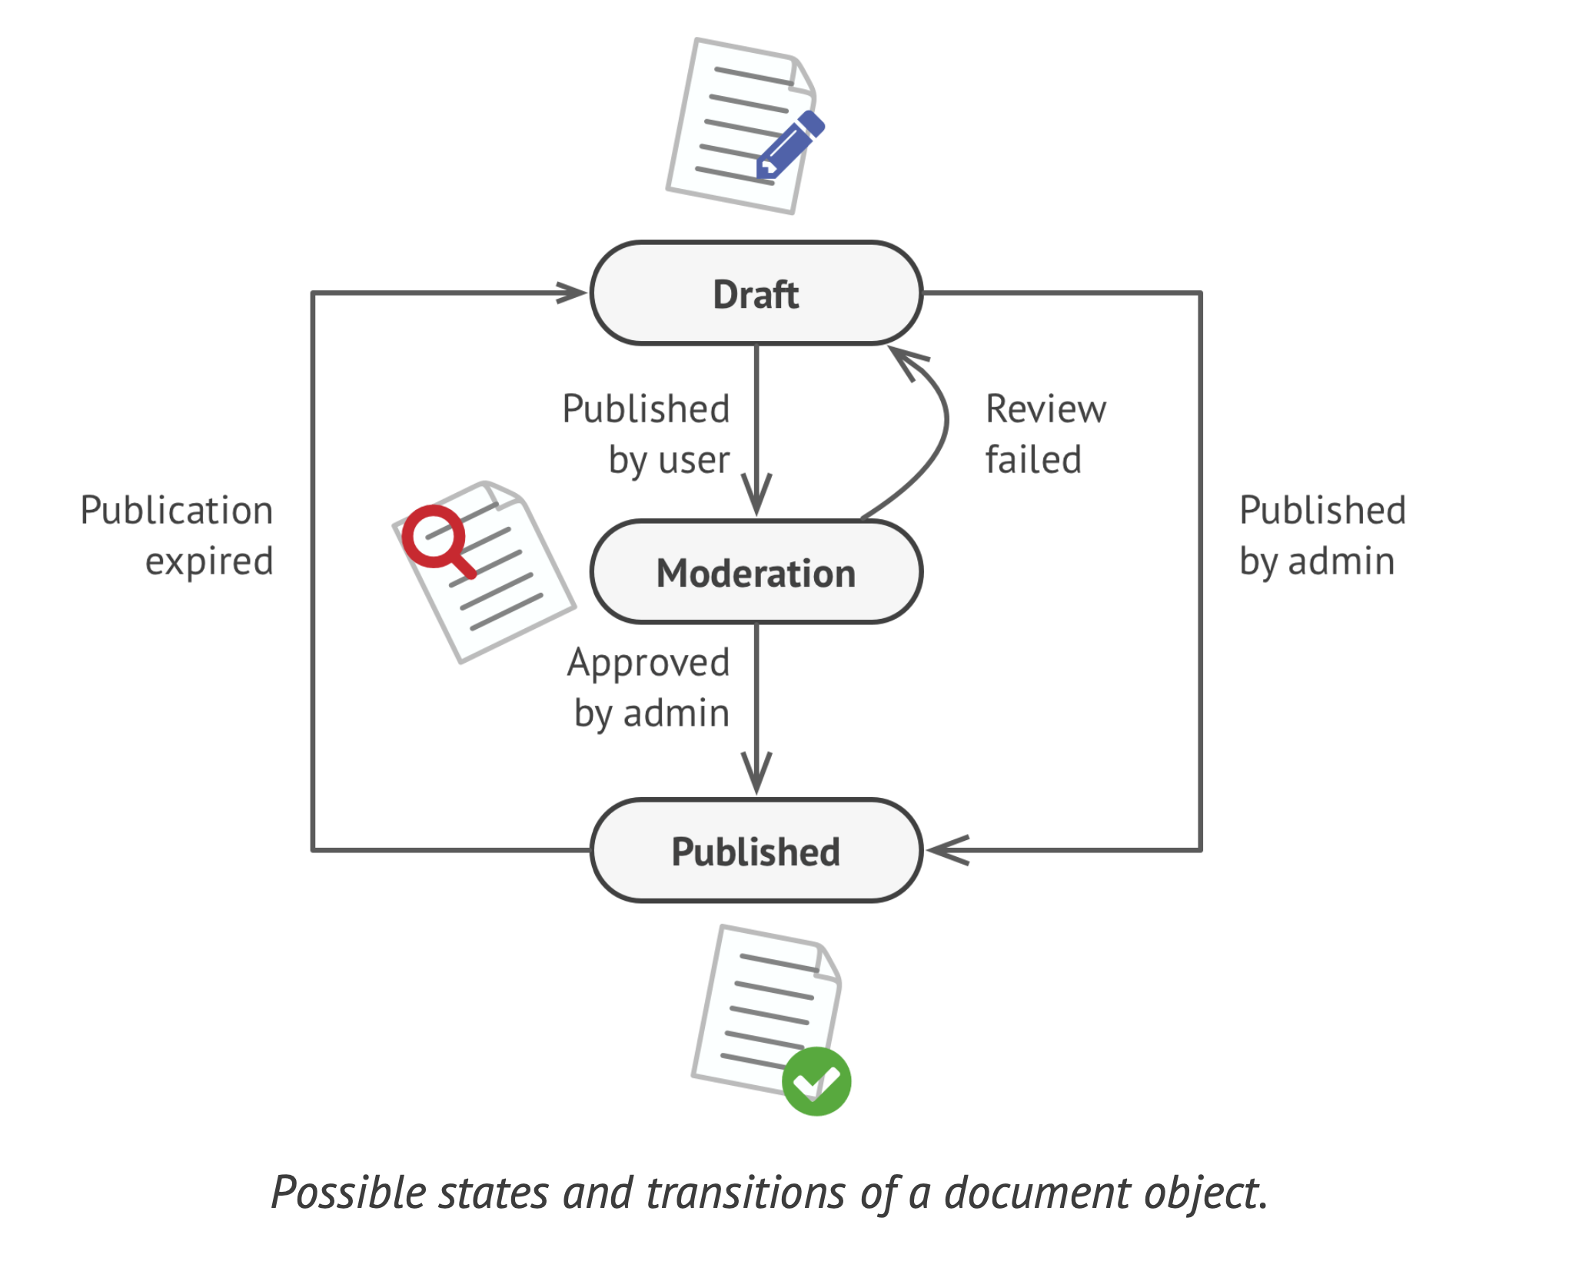
PROBLEM
Image1: Possible states and transition of a document project [1]

Slide 5
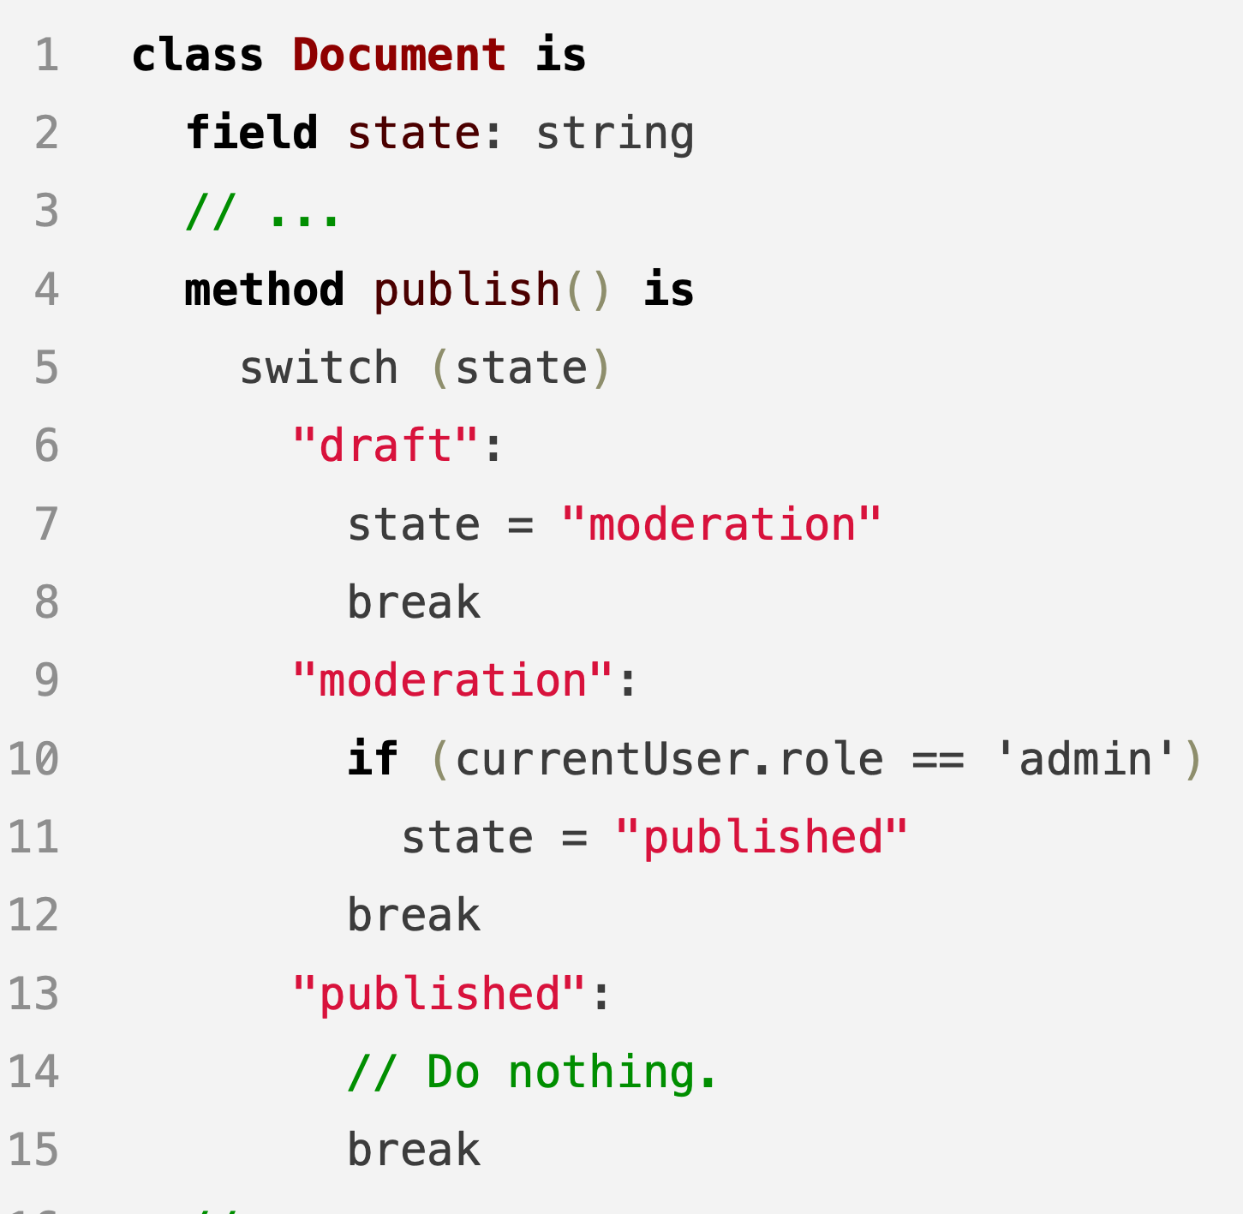
PROBLEM
Image2: Possible states and transition of a document project [1]

Slide 6
SOLUTION
The State pattern suggests that you create new classes for all possible states of an object and extract all state-specific behaviors into these classes.
Instead of implementing all behaviors on its own, the original object, called context, stores a reference to one of the state objects that represents its current state, and delegates all the state-related work to that object [1]

Slide 7
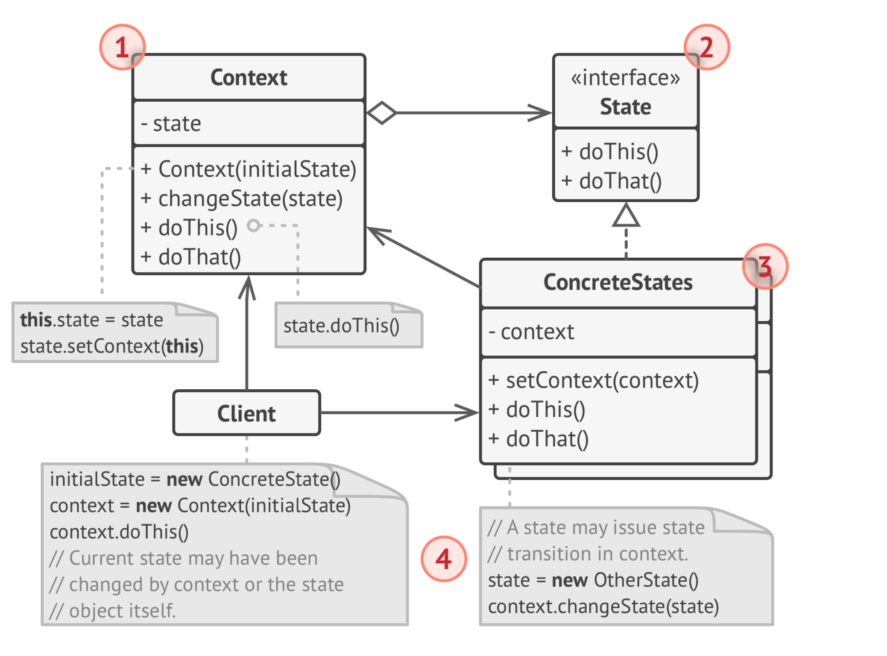
STRUCTURE
Image3: Possible states and transition of a document project [1]

Slide 8
APPLICABILITY
When you have an object that behaves differently depending on its current state, the number of states is enormous, and the state-specific code changes frequently.
You extract all state-specific code into a set of distinct classes. As a result, you can add new states or change existing ones independently of each other, reducing the maintenance cost.
When you have a class polluted with massive conditionals that alter how the class behaves according to the current values of the class’s fields. [1]

Slide 9
PROS and CONS
PROS
Single Responsibility Principle. Organize the code related to particular states into separate classes.
Open/Closed Principle. Introduce new states without changing existing state classes or the context.
Simplify the code of the context by eliminating bulky state machine conditionals. [1]
CONS
Applying the pattern can be overkill if a state machine has only a few states or rarely changes. [1]

Slide 10
THANK YOU FOR LISTENING!

Slide 11
REFERENCES
1 - https://refactoring.guru/design-patterns/state

